Slide 1
Spring 2020 iSchool Lab Assistant Orientation
IST Labs: Lab Assistant Duties and Expectations

Slide 2
Welcome Back!
Lab hours this Spring: Labs open at 7:55AM (07:55), close at 11PM (23:00) on weekdays. Saturday and Sunday opening is at 09:00 (no Sat/Sun classes, so 09:00 shift start is OK).
M-F opening shift labbies should be on shift by 07:55
Openlab (GOL-2670) hours: 24/7!
Swipe access enabled for IST/CSEC students/staff/faculty.
Door should remain closed – never propped open.
If the door is propped open, pleased gently close it.

Slide 3
Who are all these people?
Who are you (in less than 2 minutes)?
Name
Major/Year (freshman, sophomore,…1st year grad, etc.)
An interest you have outside of school/work
Optional (answer any one or two - not all):
Best professor?
Best course?
Best Co-op?
Returning labbies – one piece of advice to newbies on being a labbie

Slide 4
Lab Changes
JAMF
An Apple-approved “Mobile Device Management Solution”.What does that mean?
JAMF allows us to define what a Mac should look like (settings, OS, software,etc.), and then it implements that definition with OS installation, configuration, preferences, and installs software.
JAMF has an “ala cart” style catalog of user-installable packages
JAMF has tools to allow us to create installable, configured packages (.pkg and .dmg files
Any labbies interested in learning JAMF?

Slide 5
Lab Changes
iSchool, CSEC, and IGM lab crews may be merging!
For now, still mostly separate, but working toward a pan-GCCIS lab staff

Slide 6
Base Job Expectations
Timeliness
Be on time – green vest on, ready to work by the shift start time.
If the shift starts at 7:55AM, be in place at 07:55AM, not 8:10.
This was still a problem during Fall 2019 – it needs to be fixed

Slide 7
Base Job Expectations
Timeliness
Planned absences – known ahead of time.
Let John/Chris know via email.
Post your shift(s) to the portal (https://workportal.rit.edu/ist) at least a week in advance, earlier is better.
Posting a shift “due to previous engagement” a day or two before your shift is considered bad. Very bad. Very, very bad.. You will get a note in your “permanent record”, and you won’t get a second note…
You won’t like us when you post a shift as “missed because of previous engagement” the day before (or of) the shift:

Slide 9
Base Job Expectations
Timeliness - Unplanned Absences – last-minute emergencies
Absences when there is less than a week’s advance notice.
Post the shift as available to the portal (https://workportal.rit.edu/ist) right away – do not delay.
If less than 24 hours, notify John/Chris via email & Slack, explain need for short-notice absence.

Slide 10
Base Job Expectations
Timeliness - Emergency Absence
Bus/Train/Airplane/Automobile (etc.) problems.
Illness (woke up sick, fell ill while on shift).
Email & Slack John/Chris as soon as practical – we will need an explanation. Slack to #labassistants channel about the absence also.
If yours is the opening shift on Saturday/Sunday – phone John (or Chris) so we can ensure labs are opened. John’s mobile number is posted in the cage (maybe add it to your contacts?)
If yours is the closing shifts any day – phone John (or Chris) so we can ensure labs are closed. Slack to #labassistants channel to let labbies on-duty know you won’t be in.
“As soon as practical” means “as soon as possible, when conditions allow”. E.g., car accident? Take care of yourself first. Contact us when it is safe to do so. Do explain any delay when contacting us though.

Slide 11
Base Job Expectations
Timeliness - If delayed in starting your shift:
Notify John/Chris & on-duty labbies via Slack to #labassistants channel that you will be late (estimate arrival if possible).
Notify John/Chris & on-duty labbies via Slack to #labassistants channel that you have arrived.
If you are on-duty and your relief posts such a message:
Stay if you are able.
If you cannot stay until the delayed (not absent) labbie arrives, lock the cage and post a noticed on the cage door for students.
If the next shift is the closing shift, be sure to alert John/Chris (by phone), and let the delayed labbie know they need to contact John/Chris once they arrive (leave a note in the cage), and Slack/email them.

Slide 12
Base Job Expectations
Do NOT leave at the end your shift with the cage unlocked, and the next lab crew not on shift.
If you have to leave your shift and the next set of labbies are not in place, contact John/Chris immediately. This is especially important for all weekend shifts and any evening (1600-2000 and 2000-2300) shifts.
Basically, we cannot leave the cage and labs unlocked with no labbie on duty.
If in doubt, have people in the labs leave (unless it is a class), then lock the labs and contact John/Chris by phone or if not reachable, by email and Slack.

Slide 13
Base Job Expectations
Timeliness - Breaks
Shifts less than 6 hours do not get a scheduled break. Shifts 6+ hours must (by law) take a minimum 30 (not 29) minute break. Clock out for the break, and then clock back in.
No cigarette/vaping/etc. breaks. Bathroom breaks OK (of course).
Stepping out briefly to grab a drink is OK (maybe do it when going out to do usability/head-counts).
RIT Holidays/Closures (do not work).
Punching In/Out (missed punches, incorrect punches, clocks and “http://bill”)
We can correct your timecard only with your authorization – we cannot “assume“ or “guess“ – use the portal‘s “missed punch“ facility.
For missed punches, you must be accurate – no guessing or estimating. Do not enter 16:00 just because that was what it as supposed to be. Enter the actual time.
Check your timecard every day, send in corrections via the portal.
Do not try to clock time for two jobs at the same time!
Do not punch in/out for another labbie or TA (violation of federal law), don‘t ask someone to punch you in or out.

Slide 14
Title IX and You
Title IX started out as a federal law to diminish and eliminate sexual discrimination in education programs or activities that receive federal financial assistance/funds. A good starting point for information about Title IX can be found at: https://www2.ed.gov/about/offices/list/ocr/docs/tix_dis.html
Title IX considerations apply here in the labs; we will not tolerate any harassment or discrimination based on sex, gender identity, race, etc.. You do not have to tolerate it either. You have a responsibility to report any violations you see.
If you are having a problem, you can report the issue to Chris/John. We can address the issue, but have limited abilities, and we are compelled by law and RIT policy to report any such incident to RIT’s Title IX office. Contact and educational information can be found at: https://www.rit.edu/fa/compliance/content/training

Slide 15
Title IX and You
As of October 2019, New York State requires all student staff to undergo Title IX training. RIT now mandates this training for its student staff, and our existing labbie crew should have received notification from RIT, and we passed along the announcement we received to the lab crew.

Slide 16
Base Job Expectations
Inventory management - understand how to check out/in items:
Documentation is available in the cage
Special cases:
Some items needs the student’s signature.
Some items need two forms of ID.
Some items are checked out long-term (there will be a list of authorized students from the course professor posted in the cage) and for those we do not keep the ID card.
Not all items can be checked out by all students.
Some items (Apple iPods/iPads/iPhones/etc.) need to have AppleID’s, iCloud attachments, and passwords removed by the student before accepting the item for check-in.
What if a student has forgotten their ID card?

Slide 17
Base Job Expectations
Dress code
No sandals or open-toed shoes (we don’t want to have to fill out OSHA reports, and don’t want to see you hurt)
Reasonable (as defined by John and Chris) work attire is expected, you are not going to the beach
Be respectful of others – no crude/vile/exclusionary/incendiary/hurtful slogans etc.
Resource usage – do not abuse your access
Do not use labs as private study halls (e.g., the Usability Labs) just because you have swipe access.
The cage is a workplace, not a place for your friends to hang out
Headphones - not while on duty. Part of your job is to attend to student and faculty needs (one ear bud is ok, as long as you can attend to customer needs)

Slide 18
Base Job Expectations
Initiative
Make sure labs are clean and tidy
no debris lying about
chairs pushed in
racks patched correctly
Keyboards and mice plugged in correctly, and reasonably neat
Unhappiness and potential loss of income can occur if the labs are a mess and the on-duty labbies are watching YouTube/Netflix/etc.
Working on homework, watching Netflix etc. is OK, as long as work is done and labs are clean, and faculty/student needs are met.

Slide 19
Base Job Expectations
Basic trouble-shooting skills:
Windows
MacOS
Hardware
Network

Slide 20
Base Job Expectations
Assist faculty/students with problems.
But - you are not a TA, your job does not include helping with homework, lab assignments or with showing students how to do course-related tasks

Slide 21
Base Job Expectations
Keep labs clean, neat, organized.
Paper & debris removed.
Wipe down benches, monitors.
Chairs pushed in and accounted for.
Clean up cabling (ensure DHCP cabling is in place in Sys and Net labs).
Attend to the cleaning schedule (on portal).
No Food in labs (closed drink containers OK)!

Slide 22
Base Job Expectations
Usability
“Head counts” for certain labs, - at 15 minutes after the hour, every hour we are open. Fill in the Google sheet (find it on the portal under the “Resources” tab).
At 15 minutes before the hour, the other labbie should do a “walk about” and check on the labs (unless you are swamped in the cage).
Inventory
Check that all lab computers/monitors/keyboards/mice are in place and functional.
Repair non-functioning computers – if necessary, deploy spare computers. Many of our lab computers are under warranty, so fix simple problems, deploy a spare if a serious problem and have the vendor come in to repair.
Imaging
When necessary (John/Chris/Chintamani/labbie) can re-image lab systems.
Learn Symantec Ghost Solutions Suite and DeepFreeze operation.
Monolithic images no longer viable for macOS as of High Sierra (10.13.6)

Slide 23
Base Job Expectations
Communication
If you are having problems or are overwhelmed, let John/Chris know.
Attend to your email, not just while on shift.
Be on Slack while on shift, and if possible, before your shift and for a bit after your shift.
Discover problems early, do not let them grow.
Do not wait for another labbie to correct a problem. Ask for help/advice if you need it (we may point you to some documentation or suggest you “use the Googles”). John, Chris, Chintamani, and other labbies should be willing to help you.

Slide 24
Base Job Expectations
Consequences
For some failures/issues, we will provide a verbal and/or email warning.
For repeat and/or serious failures/issues we will provide a formal written ‘disciplinary action’ that goes in your folder. You may be restricted from picking up extra shifts.
A second formal written disciplinary action may result in termination depending on the nature/severity of the issue (a third such instance will guarantee termination).
Especially egregious issues may result in immediate termination.

Slide 25
Base Job Expectations
INITIATIVE!!!
There are always things to do in the labs – find them and take care of them
Are all cables managed properly? No? Then fix them?
Someone eating in the labs? Ask them to put the food away or step out to finish.
Are the labs clean? Monitors smudged with finger prints? Chairs, keyboards, etc. in disarray? Straighten things up. Make the Lab Great Again (MLGA???)
If you are not otherwise busy helping faculty/students or dealing with problems, one of the labbies on shift should periodically check on labs – do a “walk about“
Are labs that should be locked, locked?
Is anyone eating in the labs?
Does the openlab printer need toner/paper?
Are the teaching labs messy?

Slide 26
Base Job Expectations
Is it OK to study while on shift, watch Netflix, listen to music?
The answer is a resounding and enthusiastic “Maybe“
The answer is “Yes“ if the labs are in great shape.
If there is anything that John or Chris might see as a problem in the labs if they walk through, then the answer is “No“
John/Chris might grab you from the cage, take you to a lab, and say "show me three things wrong in this lab“.

Slide 27
Printing in the Labs
Two printers were available for students:
Cage printer (Jimmy)
Openlab printer (John)
PaperCut:
A web-based printing facility (and is an item in ‘Start’ menu).
Only prints Microsoft files (Word, Excel, …) and PDF files (but e.g., embed a JPG file in a Word doc to print it...).
Only works for IST/CSEC students (student must login to PaperCut) and is limited to 150 pages/semester. There is also a limit on the number of pages in any one document.
Student printing problems – collect the date/time, RIT username and full name, number of pages that were a problem and what happened – pass to John/Chris.
You may need to unjam printer or add paper or toner cartridges.

Slide 28
Printing in the Labs
ITS manages the PaperCut server, and currently (2019-12-17) it is not able to print. We did not change anything, and the printers work, so until ITS figures out their problem:
Students need to bring a flash drive with their PDF document to the cage
The labbie on duty (you) will print their document from the cage computer.
We will only print iSchool (IST, ISTE, NSSA, HCI, HCC) and CSEC course-related materials for assignments (e.g., sign-off sheets for lab reports).
We are not printing e-books, resumes, boarding passes, job applications, etc. We are not printing biology or chemistry or English assignments. These can be printed in the library, at the hub, or in the appropriate department.
The Openlab printer is currently not available (we do not station a labbie in Openlab to print for the students).

Slide 29
Some useful URLs
Timecard review: https://fastapps.rit.edu/kronosTimecard/login
IST Labs Site: http://www.istlabs.rit.edu
Bill Site (access to Kronos punching, only within IST labs): http://bill.istlabs.rit.edu
Student Staff Web Portal (missed punches, blog, etc., accessible outside of labs): https://workportal.rit.edu/ist/
For missed punches, https://workportal.rit.edu/ist/punches/create

Slide 30
Timeclock/Kronos
To clock in to Kronos, either use a Kronos clock or if in the Syslab or Netlab labs, use bill.istlabs.rit.edu. If bill’s connection to Kronos is down, use the Kronos clocks. The computers in the cage can also let you clock in with bill.istlabs.rit.edu (TAs - ask a lab assistant for help if needed).
To clock out from Kronos, either use a Kronos clock or if in the labs, use bill again. (Kronos punches are toggles for in/out).
If you are working outside of the labs, use the CAD portal https://workportal.rit.edu/ist/punches/create to add punches, or send email –IN THE PROPER FORMAT, AND FROM YOUR RIT EMAIIL ACCOUNT – the information about your missing or incorrect punch(es). Do not use the portal if bill.istlabs.rit.edu or a Kronos clock are available and working. The portal is for missed and erroneous punches only.
See the Lab Employee Handbook and other lab documentation for more details and checklists for punching in/out.

Slide 31
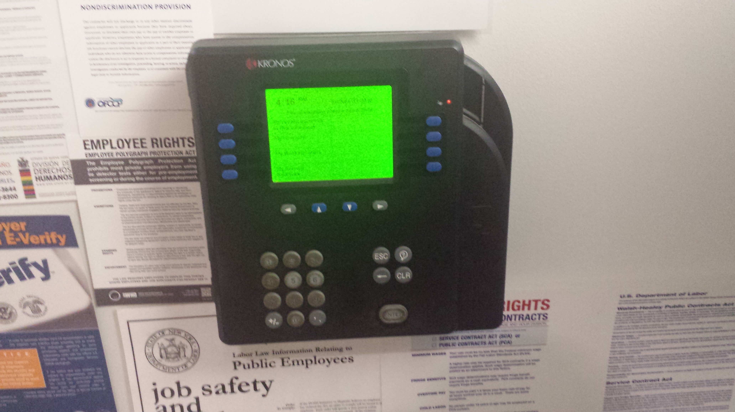
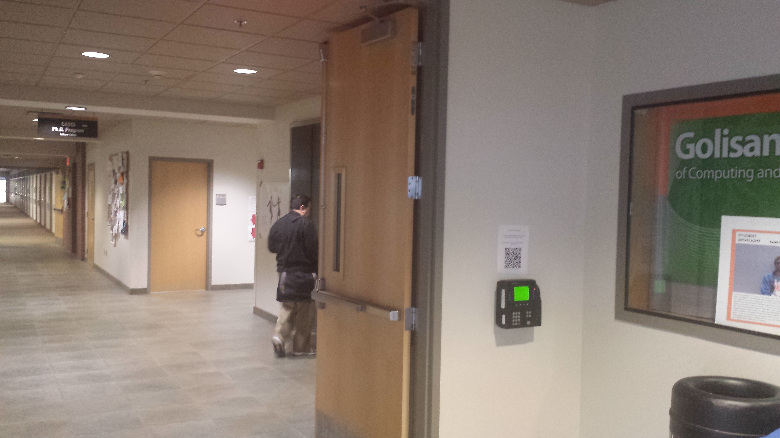
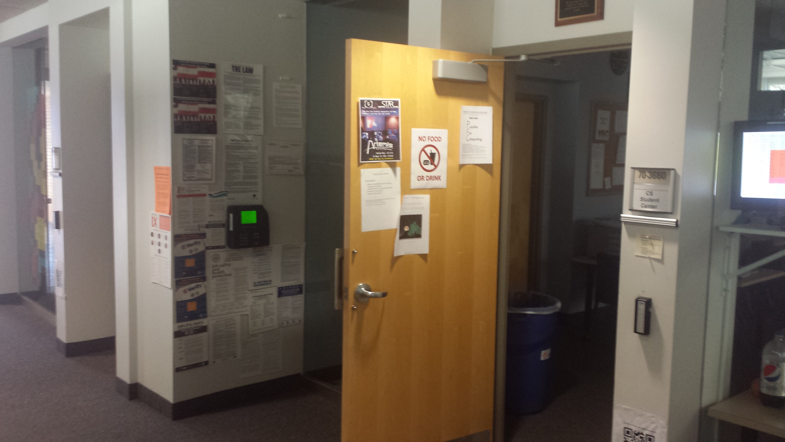
Kronos Clocks
There are two Kronos clocks in Golisano (bldg. 70) that I know of:
First floor atrium, near the double doors exiting the atrium directly south from the Control-Alt-Deli.
Third floor, near the CS Tutoring room (GOL-3660).

Slide 32
Hours
We schedule labbies less than the maximum allowed per week to get better coverage. You can pick up additional hours by covering shifts that other labbies posted as available.
Important – this is a job. You may need to miss your favorite TV show for your shift. Unavailable hours are those for which you are in class or at another job, at a regularly scheduled meeting of an official RIT organization, at an RIT sporting event as a participant (spectating does not count), or for religious reasons (typically Saturday or Sunday). Unfortunately, not everyone will get the choice shifts.
You may not go over 20 hours per week for ALL RIT jobs; if you do so, you will be warned. If you do it again, RIT (not IST) will terminate you from all campus jobs and bar you from student jobs for a period time.
Do not work gratis, that is for free. You must report all hours you work (state law, maybe federal law)

Slide 33
Problems
Unruly or confrontative/hostile students? Do not engage! Contact John/Chris (TA’s may also contact you about problem students). After normal business hours – phone John or Chris (phone numbers in cage), or if extremely concerned, contact public safety.
Fire alarms – get everyone out, lock the cage, get out! If smoke/flames in the area, don’t bother locking cage (close the cage door if you can).
Your own health and grades and family are the highest priority; labbie work is down the list – but – if the labbie work is causing problems for the top priority items, see John/Chris immediately.
Have the Tiger Safe app on your phone

Slide 34
Advanced Job Expectations
Experienced labbies may wish to take on more responsibility:
Mentoring new labbies above normal expectations.
Leading one of our sub-teams (networking, sysadmin, web/db, documentation, facilities).
Leading a project (changes to lab infrastructure, web development, etc.).
In charge of lab image creation/development.
Suggesting a project, improvements to the lab, to lab procedures, etc..
Fluent in ASL.
Advanced trouble-shooting skills.

Slide 35
Checklist
Know your shifts
Verify you can swipe into our labs
Did you get/set a PIN? No? You need one. See Chris or John
Can you use the inventory system?
No? See John – you may need a pw reset or an account created
Do you have an account in the lab’s AD?
No? See John/Chris (not critical for most, but good to have)
Have you sent John a scan/photo of your current SEO Card?
Have you been getting labbie emails from John? No? Let us know
Have you given John a head shot photo for the lab web site?
Do you have and know your Kronos number? (No? DO NOT WORK!)
Are you set up for the ISTLabs Slack channels?

Slide 36
Checklist
Can you access the portal (https://workportal.rit.edu/ist) ?
In the portal, under resources, can you access the following?
Usability – Spring 2195
Lab Maintenance Checklist
Lab Printer Cartridge Replacement Log
Lenel reader Procedures
New Labbie Guide
If you answer “no” to one or more, see John or Chris
We will post this orientation document as a an item in the portal’s resource section

Slide 37
Questions?
If you don’t ask, you won’t know, so ask:
Chris or John (IST/iSchool Sysadmins & lab managers)
Chintamani (our grad assistant)
Another labbie

Slide 38
Checklists
The following slides are a few checklists to follow for lab situations

Slide 39
Checklists: Lab Opening
Be on time - 07:55 Monday – Friday (8am classes may need your help)
Unlock/Open
Syslab (GOL-2320)
Netlab (GOL-2160)
AirGap (GOL-2130)
Cage (GOL-2140)
Green vest on

Slide 40
Checklists: Lab Closing
About 30 minutes before closing time, remind students in the following labs that “We are closing in about 30 minutes, save your work and pack up”.
Syslab (GOL-2320)
Netlab (GOL-2160)
AirGap (GOL-2130)
One labbie should check to see that the DB Labs (2520, 2620, 2650), Mac labs (3510, 3690) are locked and in good shape
That labbie should also ensure Gradlab and Openlab (2660, 2670) doors are not propped open.
Green vest off
Straighten up the Net/Sys/Airgap – chairs in place, debris removed, keyboards/mice/monitors straightened. Note any problems (dead systems? Broken monitor? Missing items?_ in a posting to Slack #labassistants
Lights out, lock up the labs mentioned above, be sure to take care of #7 below before locking the last of the labs.
Ensure the door from Syslab into the Netlab/Cage/Airgap is closed

Slide 41
Next Shift Labbies missing?
If your shift is about to end, and your relief (the labbies that take the next shift) are not here.
Slack them – see if they are coming. If there is no response, and you cannot stay a few extra minutes
During M-F business hours (8am-5pm) find John or Chris
All other times call John/Chris to let them know you need to leave, and the next shift is not here. John’s phone # is posted in the cage.
Lock the cage, put a notice on the whiteboard.
If you could NOT contact John or Chris and get a response from them, you need to lock Sys/Net/Airgap – apologize to students, but they need to leave (follow the lab closing procedures checklist).

Slide 42
Long-term Checkout of Equipment
Long-term checkouts (anything that is not returned the same day) must be allowed only for faculty or students that are on a posted list for a specific course or project. The list is provided by a faculty member and OK’d by John or Chris, or otherwise authorized by John or Chris.
If in doubt, see John or Chris.
Fill out the paperwork (see the binders on the shelves next to the checkout station) completely. Provide a copy of the agreement to the student.
The person borrowing the equipment must read the agreement, and understand when the item must be returned.
If they borrow Apple device, make sure they understand they need to remove their AppleID from the device before returning it.

Slide 43
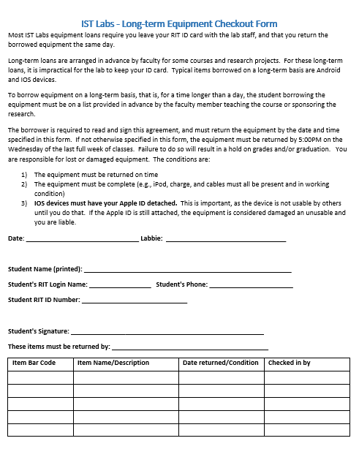
Sample Long-term Checkout Form

